Slide 1
Secure Data Hiding in Image Using Steganography
CAPSTONE PROJECT
Presented By: Anupriya Bharat Dadhich
College Name & Department : Banasthali Vidyapith (MCA)

Slide 2
OUTLINE
Problem Statement
Technology used
Wow factor
End users
Result
Conclusion
Git-hub Link
Future scope

Slide 3
Problem Statement
The problem statement is that to hide the confidential information from the unauthorized user and sharing it to the authorized user .
To solve this problem Steganography is best way to solve this problem as we can hide the text ,audio,video inside a image and encrypt it with the key and then share it to the end users.

Slide 4
Technology used
Software Requirement : 1) Windows of 64 bits.
2) Python IDLE .
Hardware Requirement : 1) Internal Drive of 914.
2) External Drive of 230.

Slide 5
Wow factors
This technique use Advanced Encryption Standard (AES) is a widely-used encryption algorithm that protects data by converting it to an unreadable format. AES is considered secure against known attacks and is used to protect sensitive data during storage and transmission .

Slide 6
End users
Since this is a good way of hiding and protecting the confidential information . Then the users such as Government Officials like Army , Navy , Air force ,CBI,NCB etc ,use this technique to hide the confidential information and send it to another official and prevent the data for getting corrupted by opposite side(enemy) .
Even the big MNC’s can also use this technique to project their strategies from their marketing competitors.

Slide 7
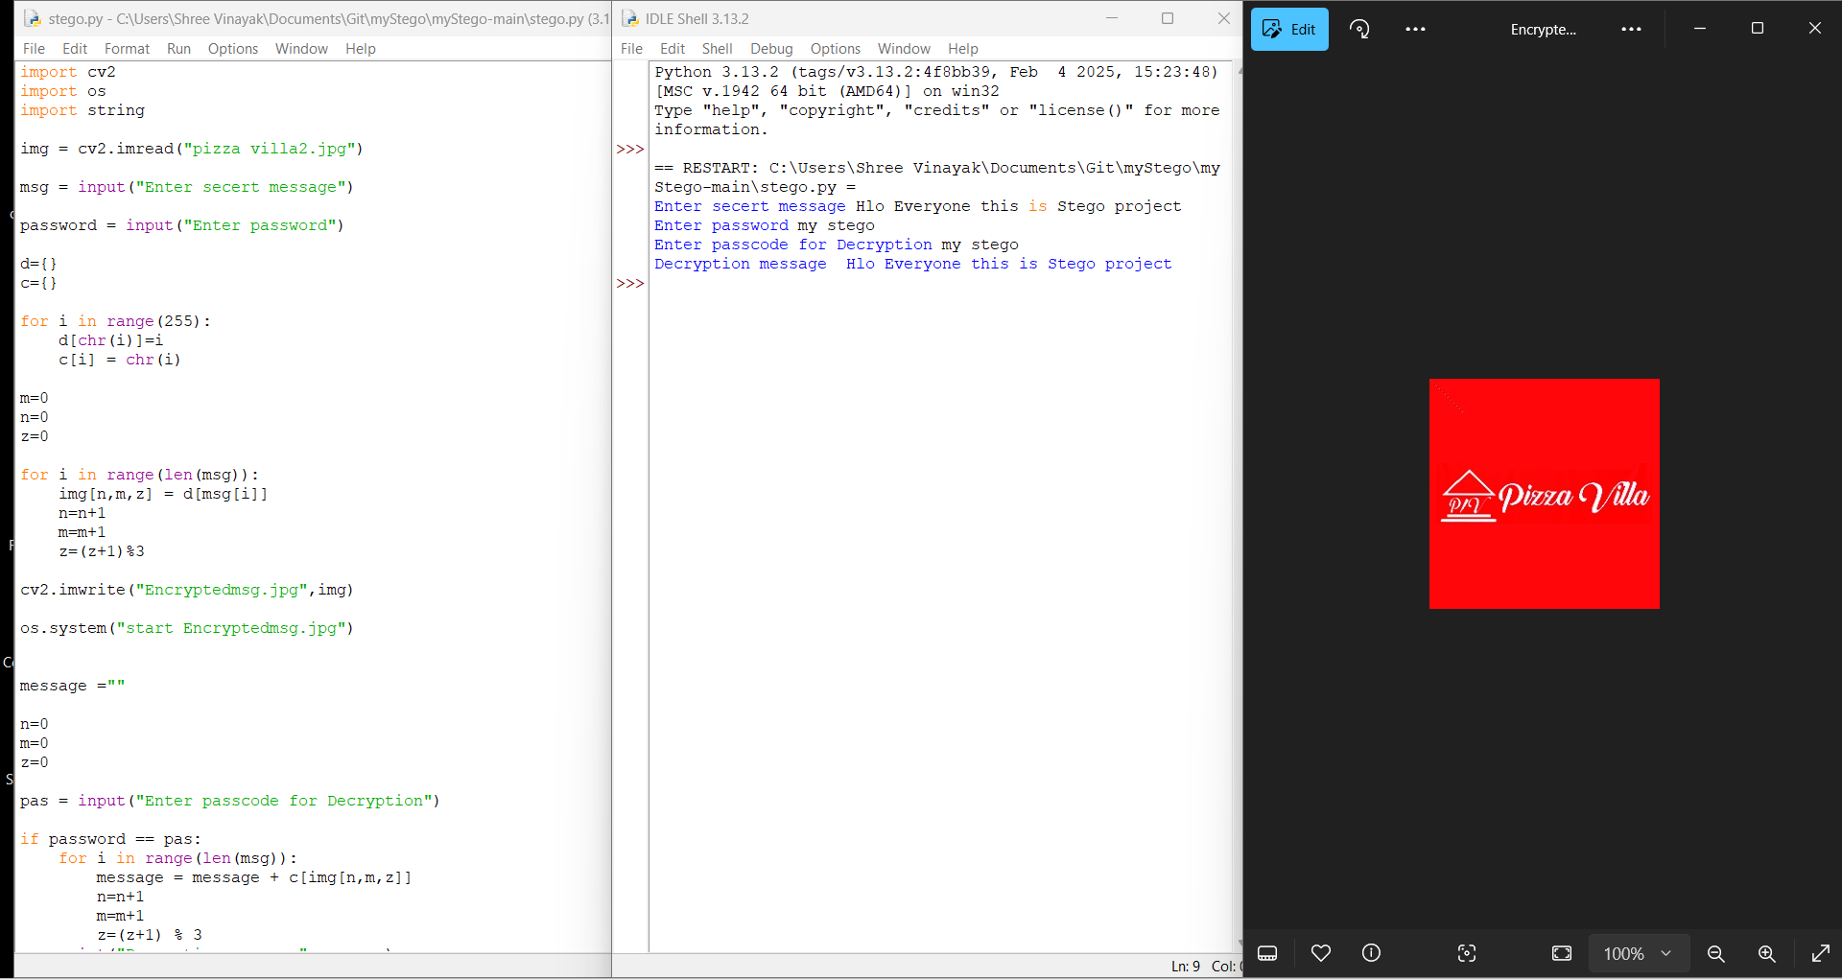
Results

Slide 8
Conclusion
This is one of the great technique to hide data and secure it from unauthorized access . This is a good technique to share the information by hiding to authorized user without letting know the unauthorized access .

Slide 9
GitHub Link
https://github.com/Apdadhich07/Stegano.git

Slide 10
Future scope(optional)
The future scope in Steganography is we can hide a confidential image ,audio, video behind a image using this technique of Steganography .
We can also use this technique in our daily life to protect our information’s integrity , confidentiality .

Slide 11
THANK YOU

